Slide 1
2023 Spring Data General Registration
Trident Technical College

Slide 2
CONTENTS
01
Team Members
Stephen A. Prine, Wilson Curtis, Joshua T. McMorrow, John H. Percival.
02
Problem To Solve
New Registration System.
03
Approach
Sprint Meeting, Trello, Standup Meetings….
04
Architecture
SpringBoot, Thymeleaf, MySql, Java, JavaScript, HTML…
05
Problems And Solutions
Learning SpringBoot, re-learngin Javascript……
06
Future Direction
07
How The Product Works?
Register, Login, Menu, Change……

Slide 3

01
TEAM MEMBERS
STEPHEN A. PRINE
Stephen A. Prine.
A Charleston born native. Started his path of education at Trident Tech College Fall 2021. Is going on the lead a team of engineers from google. His favorite past time is cycling, and throwing his dogs frizbe endless amount of times at the dog park.

Slide 4

CURTIS WILSON
Curtis is coming to Trident after spending 20 yrs in the hospitality industry. He believes it’s important to continue to learn new skills and to stretch your comfort zones. Software design is challenging and engaging.

Slide 5

JOSHUA T. MCMORROW
Joshua T. McMorrow
From Long Island New York.
Returning Trident Tech student after going to Temple University for finance.
Going to continue his software
development journey at Liberty Mutual. Enjoys hanging with the dogs, playing
video games, developing small games with friends.

Slide 6
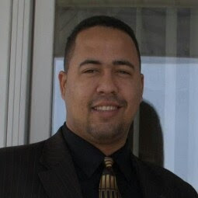
JOHN H. PERCIVAL
After working in construction industry for far too long. John realized it was time for a change. This is my first university experience in this country and without a doubt it has marked me for the rest of my life. As an immigrant, there have been many challenges that I have had to face, but I know that with effort and dedication, living one day at a time, you can get out. Go ahead I hope thanks to the college I have a better future.

Slide 7
02
PROBLEM TO SOLVE
Create a webpage so that the student can register, and log in. Once inside, they can see what the mandatory or optional requirements are for their major. They can filter courses and can register with a username and password. Students can register for one or more terms at a time. They can select a major at the time of registration. This record will only show the courses that correspond to your study plan. The system should have an administrator side that can search for students, and modify student information, courses, core, and grades.

Slide 8

03
APPROACH
We met with Product Owner Bi-Weekly
Organized our ideas and task via Trello .
Follow Work Progress With Discord Board.
Standup meetings.
Clear communication.

Slide 9

04
ARCHITECTURE
FRONT-END:
HTML/CSS/JavaScript
FrameWork
Apache/Maven
BACK-END
Java
DataBase
MYSQL, WorkBench
WebServices
SprintBoot, Thymeleaf
IDE
VSCODE

Slide 10

05
PROBLEMS AND SOLUTIONS
PROBLEM
SOLUTION
New Tool: SpringBoot,
Thymeleaf.
Using Github,
Git, Github Desktop
Team Communication.
Task assignation.
Standup Meeting
Learning Springboot, Thymeleaf
Learning Git Hub, Tutorial and Advisor. How to use from Command Line
Improve Communication and Standup Meeting with Discord.
Group meeting after the meeting with the product owner to assign tasks and share impressions.

Slide 11

06
FUTURE DIRECTION
Class Enrollment Email Confirmations
Optimize for Mobile Application
Course Information: Instructor, Textbook, tools, supply.
Search to find courses and filter by teacher.

Slide 12

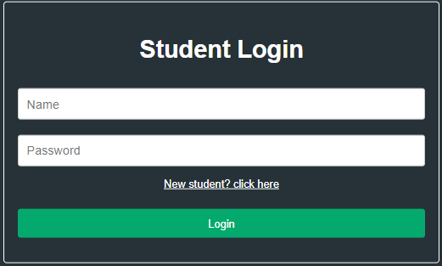
07
HOW IT WORK?....DEMOSTRATION

